Slide 1
Machine learning CS 229 / stats 229

Slide 2
Meet the team
Instructor: Anand Avati
Course Coordinator: Amelie Byun
Course Advisor: Swati Dube Batra
Head TA: Taide Ding
TA: Hao Sheng
TA: Fereshte Khani
TA: Kelly Shen
TA: Will Deaderick

Slide 3
Goals
By the end of the course,
Be an expert in ML (understand the internals of ML algorithms)
Be able to build ML applications (know which algorithms to use when)
Be able to start ML research (read research papers)

Slide 4
Prerequisites
Basic computer science principles
Big-O notation
Comfortably write non-trivial code in Python/numpy
Probability (CS 109, STATS 116 etc.)
Random Variables
Expectations
Distributions
Linear Algebra & Multivariate/Matrix Calculus (MATH 51, etc.)
Gradients and Hessians
Eigenvalue/vector
Check your background with Homework 0!

Slide 5
Honor code
Form study groups (strongly encouraged!)
Homework can be submitted in pairs. One pair cannot submit more than one HW.
It is an honor code violation to intentionally refer to a previous year's assignments (either writeup or code).

Slide 6
Course structure
Summer version:
7.5 weeks (instead of usual 10-11 weeks)
No project
Grading: 3 HWs at 60% (3 x 20%), Final exam at 40%
Healthy mix of math and Python coding
More topics and math in lieu of final project
Summer 2020 version: Re-stream lecture videos from Summer 2019.
Videos released in weekly batches (2-4 per week), on the Friday of prev week.
Instructor OH: weekly

Slide 7
Logistics
Course website (calendar, syllabus, notes) - http://cs229.stanford.edu
Lectures on Canvas / Course Videos
Piazza
Gradescope
Office Hours (Zoom link and Password, Queuestatus)

Slide 8
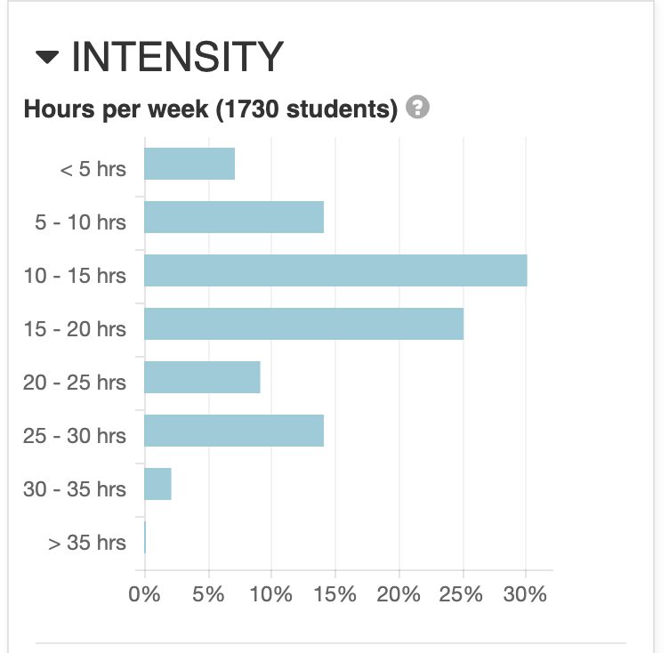
What to expect
Can be a challenging course, requires commitment!
But it’s doable, and the teaching staff is here to help!

Slide 9
What is ml?
Term “Machine Learning” coined by Arthur Samuel in 1959.
Samuel Checkers-playing Program
Common definition (by Tom Mitchell):
Machine Learning is the study of computer algorithms that improve automatically through experience
Subfield of Artificial Intelligence (AI)
The hottest subfield - reinvigorated interest in AI due to deep learning!

Slide 10
Recent progress
Computer Vision / Image Recognition
ImageNet
Convolutional Neural Networks
Autonomous driving
Speech Recognition
Voice assistants
Language Translation
Google Translate
Unsupervised Translation
Game Playing / Deep Reinforcement Learning
ATARI
AlphaGo

Slide 11
Course Preview
Week 1 – Mathematical Background (3) Linear Algebra, Matrix Calculus Probability and Statistics | Week 5 – Reinforcement Learning (2) MDP, Value / Policy Iteration, Bellman Eqn Continuous States, Fitted VI
Week 2 – Supervised Learning (4) Linear and Logistic Regression, Gradient Descent Exponential Family, Generalized Linear Models Gaussian Discriminant Analysis, Naïve Bayes | Week 6 – Unsupervised Learning (3) K-means, GMM, EM, Factor Analysis PCA, ICA
Week 3 – Supervised Learning (2) Kernel Methods Bayesian Methods | Week 7 – Advanced / Other Topics (3) Maximum Entropy, Proper Scoring Rules Variational Inference, VAE Evaluation Metrics
Week 4 – Deep Learning (2), Learning Theory (2) Neural Networks, Backpropagation Bias/Variance, Regularization, Uniform Convergence | Week 8 – Conclusion (2) Practical Advice and Tips Course Recap

Slide 12
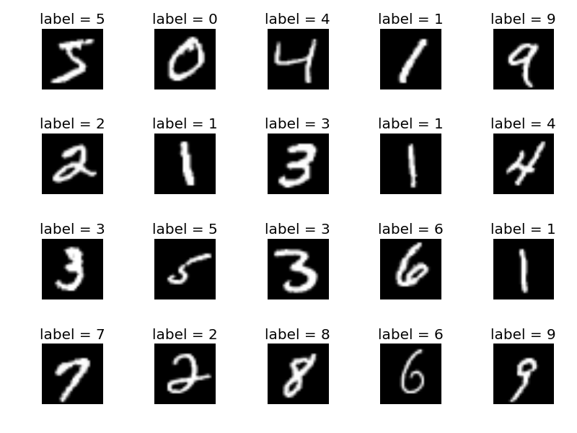
Preview - Supervised

Slide 13

PREVIEW – UNSUPERVISED (ICA)
Mixed
Separated

Slide 14
PREVIEW – UNSUPERVISED (ICA - II)
Mixed
Separated

Slide 15
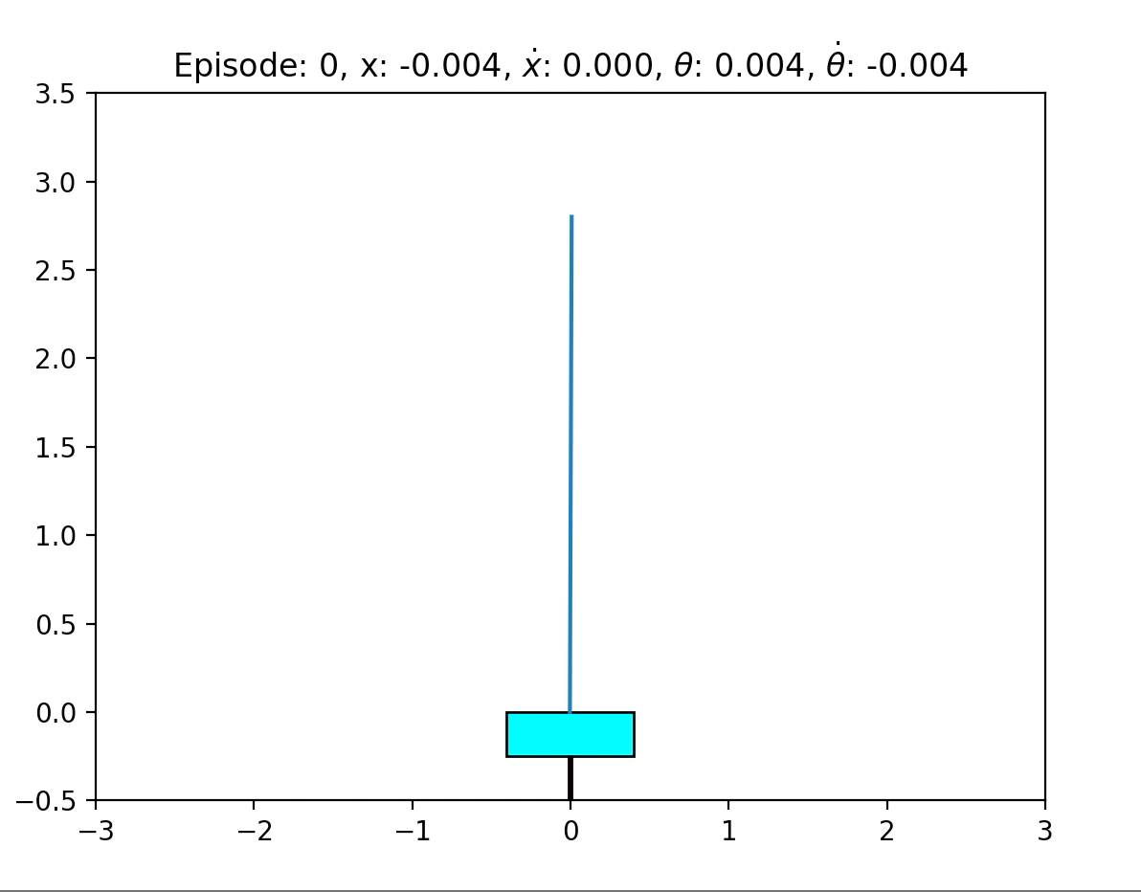
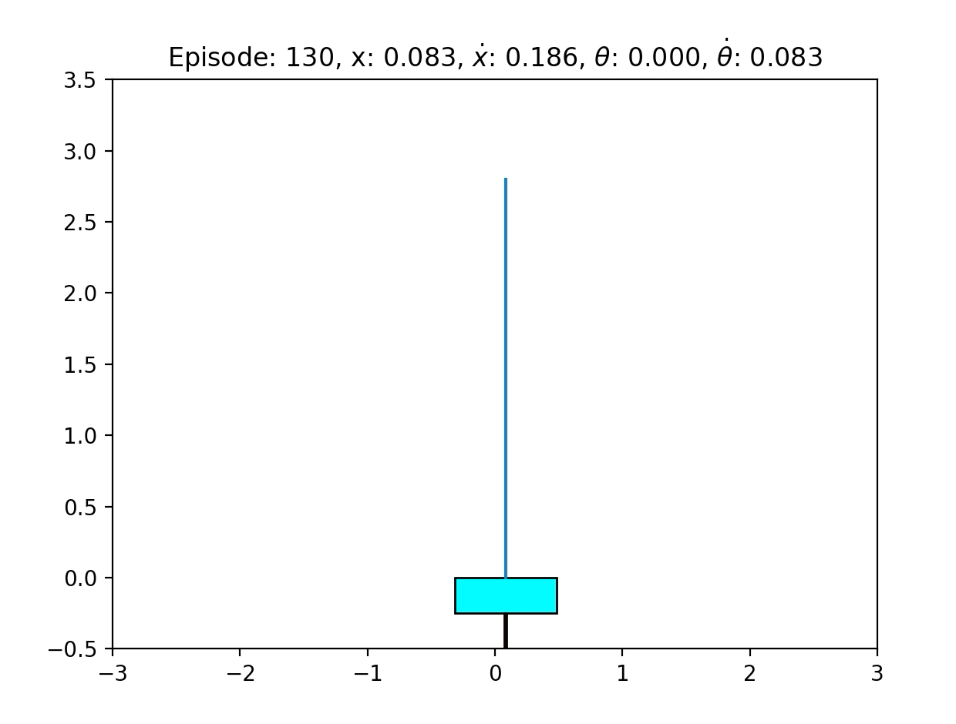
PREVIEW – REINFORCEMENT LEARNING

Slide 16
Good luck!

